Slide 1
BANGLORE HOUSE PREDICTION
Data driven pricing using Regression Analysis

Slide 2
Objective
Predict the price of residential properties in Bangalore
Help buyers, sellers, and real estate agents make informed decisions
Identify how various features (size, location, BHK, etc.) affect property price

Slide 3
Approach and Solution
Steps Followed:
Data Preprocessing (handled missing values, encoded categorical features)
Exploratory Data Analysis (EDA) with Seaborn & Matplotlib
Outlier removal using 99th percentile of Price per Sqft
Model Training using Linear Regression
Model Evaluation using R², MAE, RMSE
Prediction for new input data

Slide 4
Data Insights using EDA
Key Observations:
Average property price: ₹112.56 Lakhs
2 & 3 BHKs are most common
Higher BHK usually means higher price, but with variance
Strong correlation between price and Total Sqft.
Small homes in prime locations → higher price per sqft

Slide 5
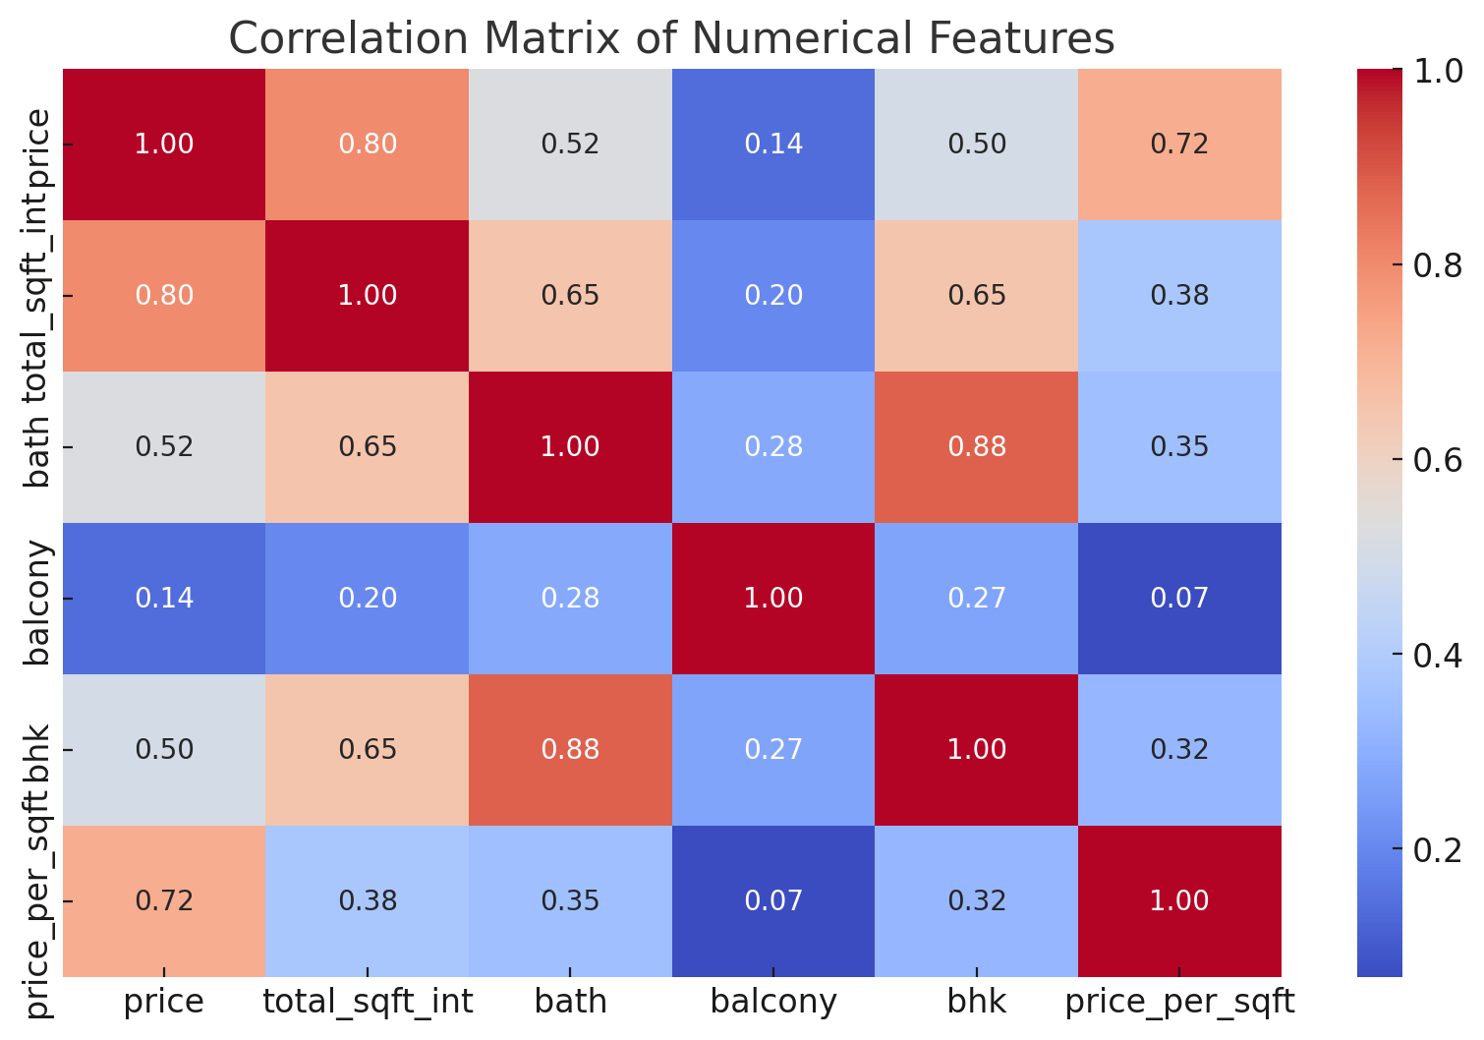
Correlation Heatmap

Slide 6
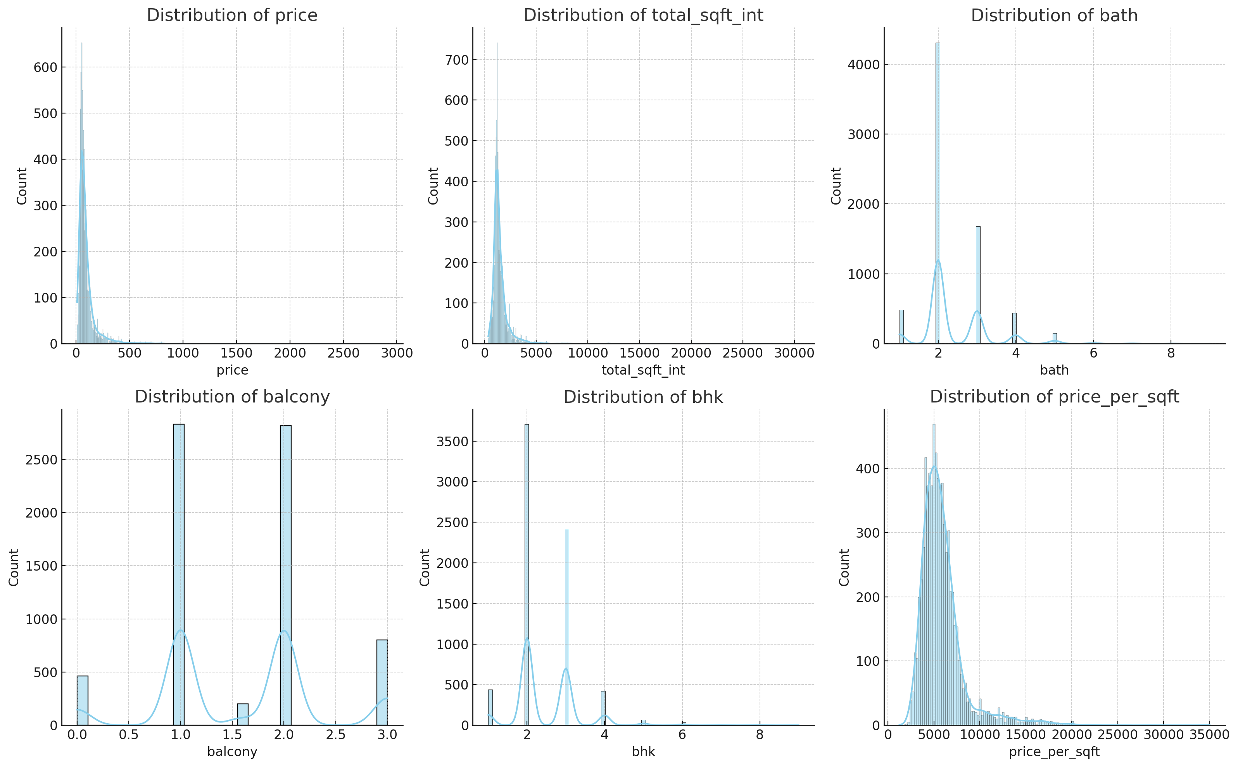
EDA Insights chats

Slide 7
Model Performance Data
Root Mean Squared Error = 30.99 lakhs
Mean Absolute Error = 17.57 lakhs
R2 Value = 0.78

